Slide 1

Generics

Slide 2
Contents at a Glance
Generics - Generic Class
Creating Generic Classes
Generic Methods
Bounded Type
Bounded Wild Cards

Slide 3
Generics
Generics, introduced by JDK 5.
The term generics means parameterized types.
Parameterized types are important because they enable you to create classes, interfaces, and methods in which the type of data upon which they operate is specified as a parameter.

Slide 4
Generics
The classes, interfaces, and methods created using generics work in a type-safe manner with various kinds of data.
A class, interface, or method that operates on a parameterized type is called generic, as in generic class or generic method.
Generics added a new syntactical element to the Java language and also caused changes to many of the classes and methods in the core API (mainly in collection classes).

Slide 5
Generics
Many algorithms are logically the same no matter what type of data they are being applied to.
For example, a method to sum the array elements where array is storing items of type Integer, Float, or Double.
With generics, you can define an algorithm once, independently of any specific type of data, and then apply that algorithm to a wide variety of data types without any additional effort.

Slide 6
Generics
Generics mainly affected the Collections Framework.
The Collections Framework defines several classes, such as lists and maps, that manage collections (group of objects).
The benefit that generics add is that the collection classes can now be used with complete type safety.
With generics, all casts are automatic and implicit.
Generics expand your ability to reuse code and let you do so safely and easily.

Slide 7
Advantages of Java Generics
Type-safety : Generic object deals with a specific data type at a time in safely manner.
Type casting is not required: There is no need to typecast the object.
Code Reusability: Generics allow us to write code that will work with different types of data.
Compile-Time Checking: It is checked at compile time so problem will not occur at runtime.

Slide 8
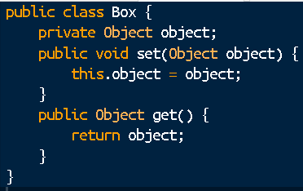
A Simple Box Class
Begin by examining a non-generic Box class that operates on objects of any type.
It needs only to provide two methods: set, which adds an object to the box, and get, which retrieves it.

Slide 9
A Simple Box Class
Since its methods accept or return an Object, one can pass whatever he/she wants, provided that it is not of the primitive types.
One part of the code may place an Integer in the box and expect to get Integers out of it, while another part of the code may mistakenly pass in a String, resulting in a runtime error.

Slide 10
A Generic Version of the Box Class
A generic class is defined with the following format:
class name<T1, T2, ..., Tn> {
/* ... */
}
The type parameter section, delimited by angle brackets (<>), follows the class name.
It specifies the type parameters (also called type variables) T1, T2, ..., and Tn.

Slide 11
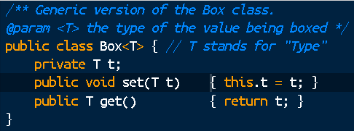
A Generic Version of the Box Class
To update the Box class to use generics, we need to introduce the type variable, T, that can be used anywhere inside the class.

Slide 12
A Generic Version of the Box Class
All the occurrences of Object are replaced by T.
A type variable can be any non-primitive type you specify.
It may be any class type, any interface type, any array type, or even another type variable.
Same technique is used to create generic interfaces.

Slide 13
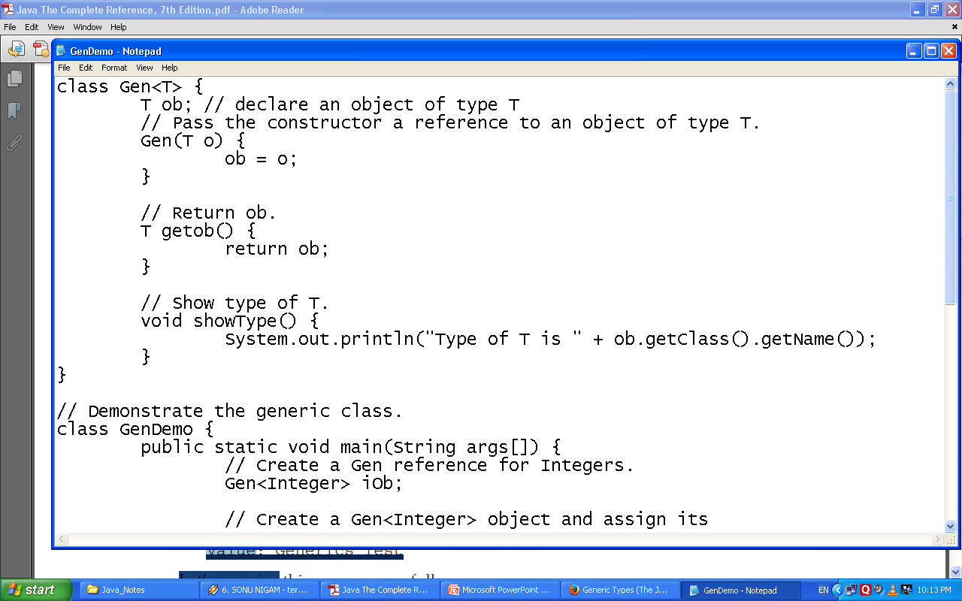
Example

Slide 14
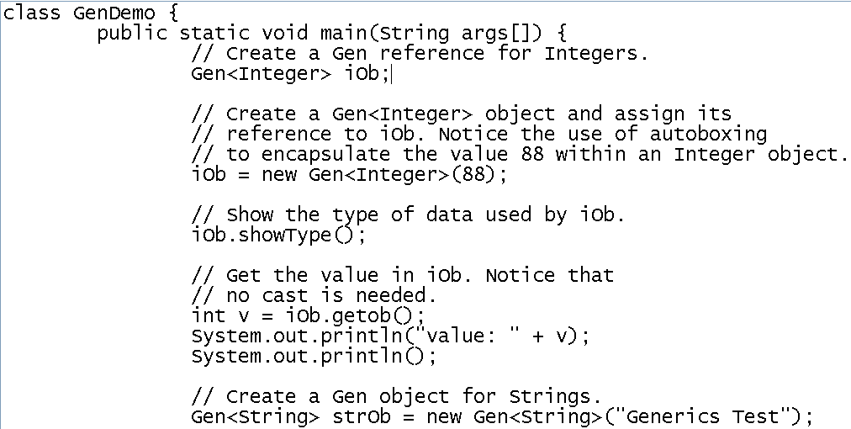
Example

Slide 15
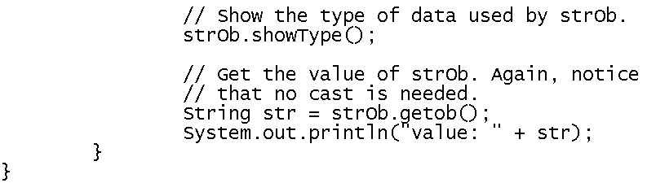
Example
The output produced by the program is shown here:
Type of T is java.lang.Integer
value: 88
Type of T is java.lang.String
value: Generics Test

Slide 16
More About Program
class Gen<T> {
Here, T is the name of a type parameter.
This name is used as a placeholder for the actual type that will be passed to Gen when an object is created.
Thus, T is used within Gen whenever the type parameter is needed.
T is contained within < >; which is syntax for generics.

Slide 17
More About Program
T ob; // declare an object of type T
As explained, T is a placeholder for the actual type that will be specified when a Gen object is created.
Thus, ob will be an object of the type passed to T.
For example, if type String is passed to T, then in that instance, ob will be of type String.

Slide 18
More About Program
Gen(T o) {
ob = o;
}
Notice that its parameter, o, is of type T and its data type is determined by the type passed to T when a Gen object is created.

Slide 19
More About Program
T getob() {
return ob;
}
The type parameter T can also be used to specify the return type of a method.
The showType() method displays the type of T by calling getName() on the Class object returned by the call to getClass() on ob.

Slide 20
More About Program
The getClass() method is defined by Object.
It returns a Class object that corresponds to the type of the class of the object on which it is called.
Class defines the getName() method, which returns a string representation of the class name.

Slide 21
More About Program
Gen<Integer> iOb;
Consider the above statement wherein Integer is a type argument that is passed to Gen’s type parameter, T.
This creates a version of Gen in which all references to T are translated into references to Integer.
Thus, for this declaration, ob is of type Integer, and the return type of getob( ) is of type Integer.

Slide 22
More About Program
iOb = new Gen<Integer>(88);
Consider the Gen constructor calling wherein the type argument Integer is specified.
Type specifying is required because the type of the object (in this case iOb) to which the reference is being assigned is of type Gen<Integer>.
Thus, the reference returned by new must also be of type Gen<Integer>. If it isn’t, a compile-time error will result.

Slide 23
More About Program
The program obtains the value of ob using following line:
int v = iOb.getob();
Because the return type of getob() is T, which was replaced by Integer when iOb was declared, the return type of getob() is also Integer, which unboxes into int when assigned to v (which is an int).
Thus, there is no need to cast the return type of getob( ) to Integer.

Slide 24
Generics Work Only with Objects
When declaring an instance of a generic type, the type argument passed to the type parameter must be a class type.
You cannot use a primitive type, such as int or char.
Therefore, the following declaration is illegal:
Gen<int> strOb = new Gen<int>(53);
// Error, can't use primitive type

Slide 25
Generic Types Differ Based on Their Type Arguments
A generic types (e.g. iOb) is a reference of one specific version of a generic type and is not type compatible with another version of the same generic type (e.g. strOb).
For example, the following line of code is in error and will not compile:
iOb = strOb; // Wrong!

Slide 26
Generic Types Differ Based on Their Type Arguments
The objects iOb and strOb are of type Gen<T>, they are references to different data types because their type parameters differ.
This is part of the way that generics add type safety and prevent errors.

Slide 27
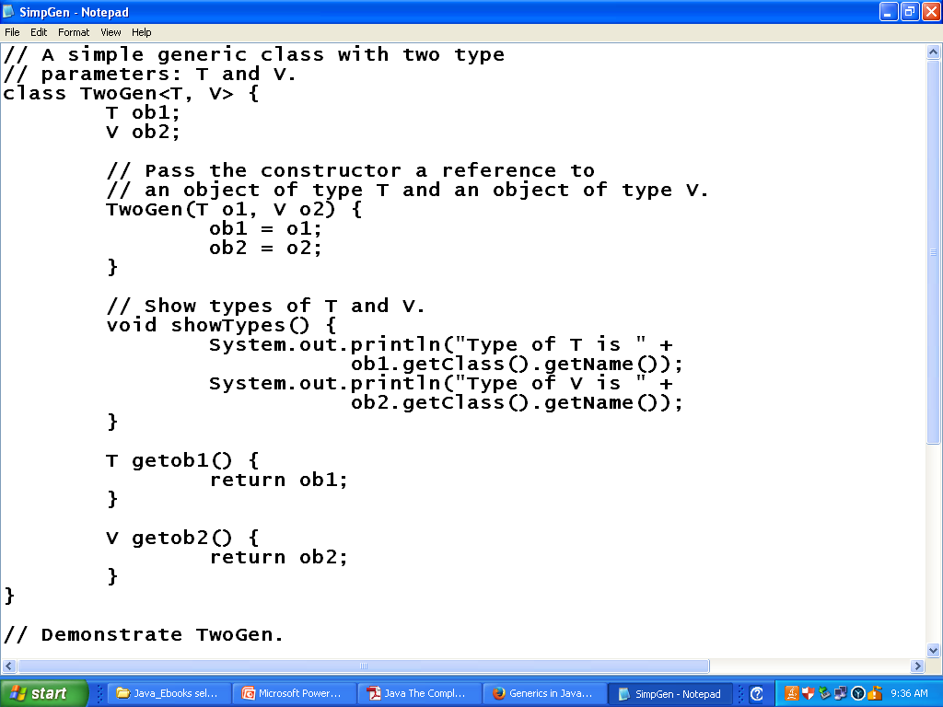
A Generic Class with Two Type Parameters

Slide 28
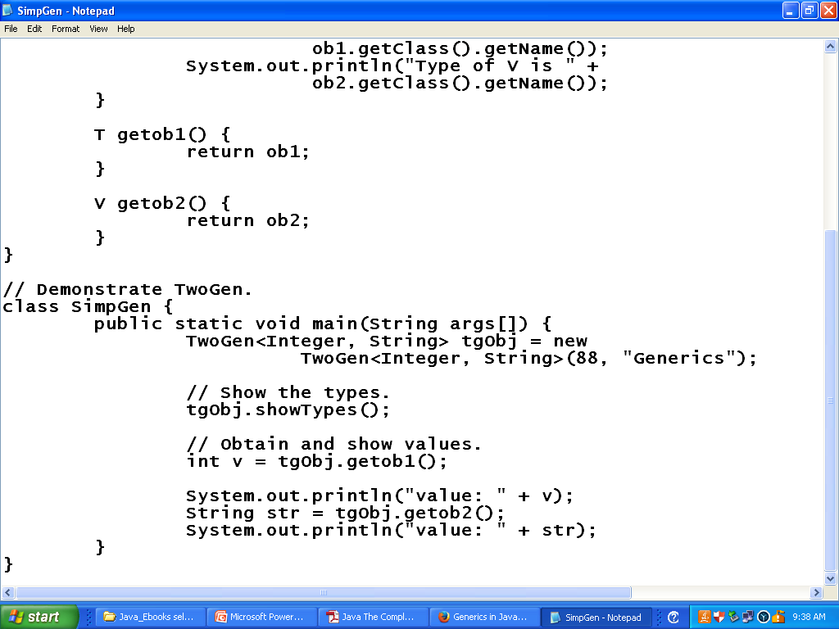
A Generic Class with Two Type Parameters
The output from this program is shown here:
Type of T is java.lang.Integer
Type of V is java.lang.String
value: 88
value: Generics

Slide 29
The General Form of a Generic Class
The generics syntax can be generalized as –
for declaring a generic class:
class class-name<type-param-list> { // ...
for declaring a reference to a generic class:
class-name<type-arg-list> var-name = new class-name<type-arg-list>(cons-arg-list);

Slide 30
Bounded Type
Sometimes it is useful to limit the types that can be passed to a type parameter.
For example, a method that operates on numbers (e.g. method that returns the average of an array of numbers) might only want to accept instances of Number or its subclasses.
This is what bounded type parameters are for.

Slide 31
Bounded Type
To declare a bounded type parameter, list the type parameter's name, followed by the extends keyword, followed by its upper bound, which in this example is Number.

Slide 32
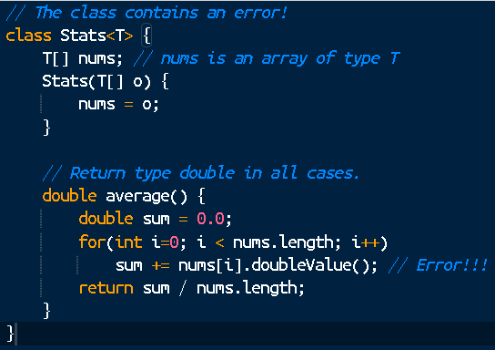
Bounded Type
doubleValue() is a method defined by Number class and all numeric classes such as Integer and
Double are subclasses of Number class.
But this method is not present with other types of Object hence “method is unknown” error occurs at runtime.

Slide 33
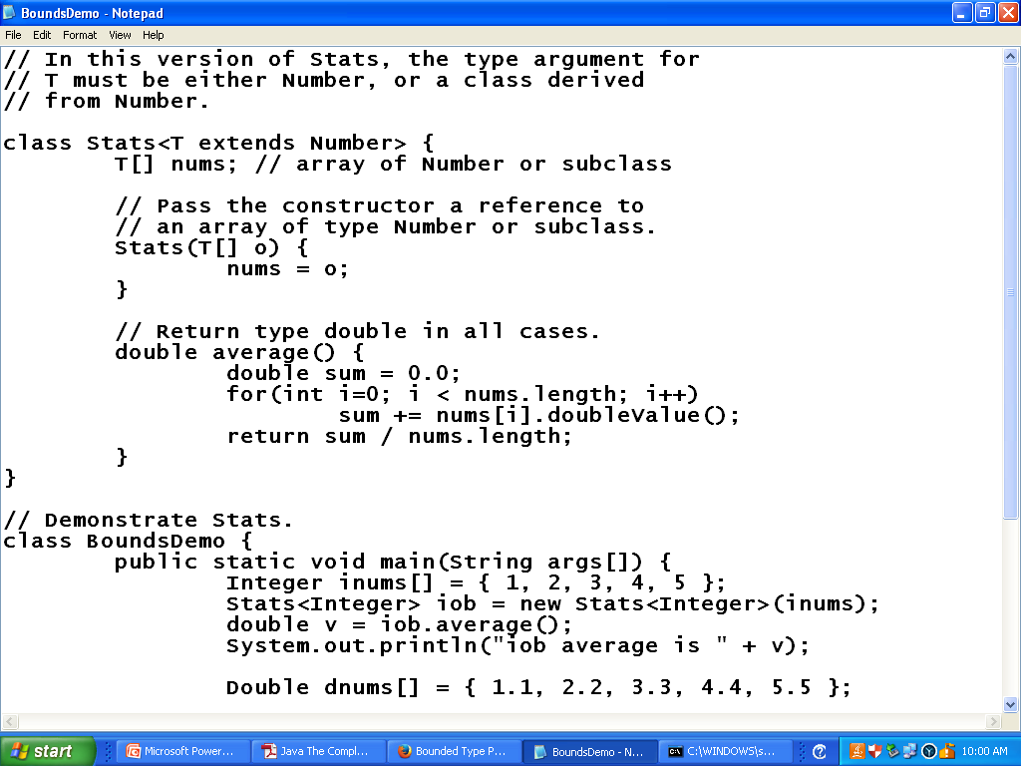
Bounded Type

Slide 34
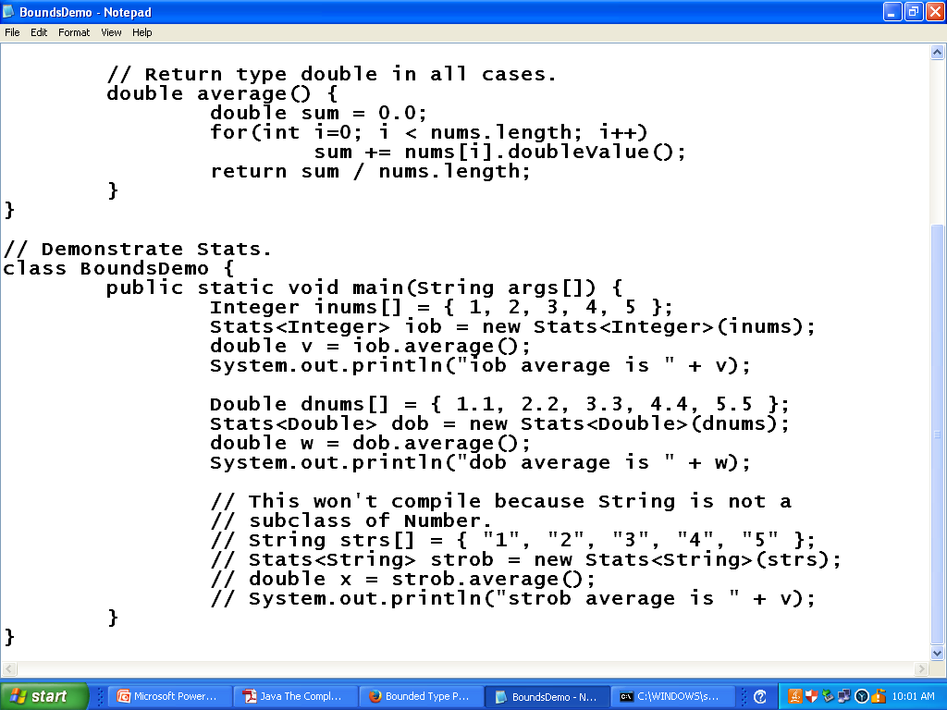
Bounded Type
The output is shown here: Average is 3.0
Average is 3.3

Slide 35
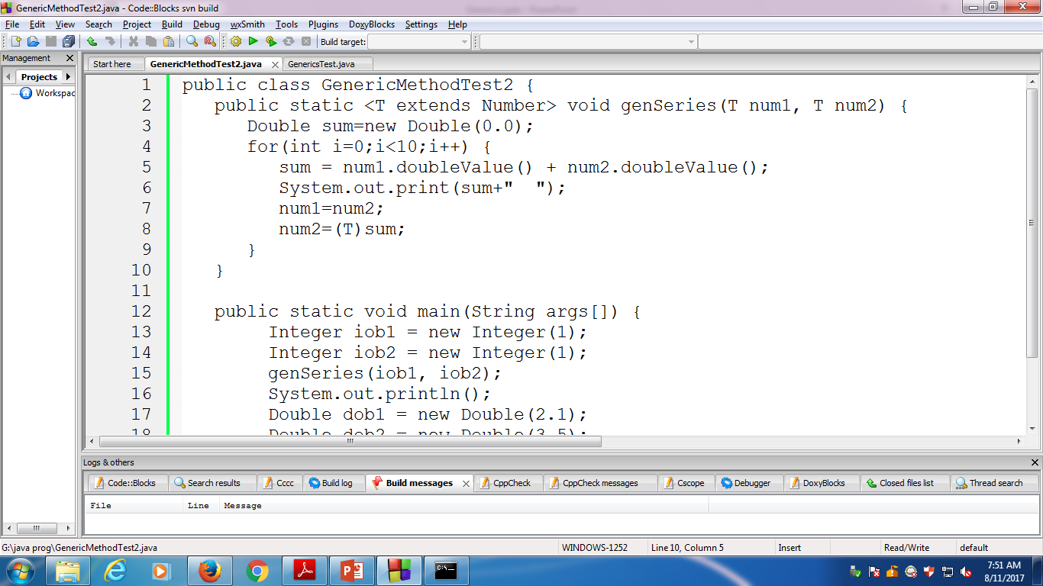
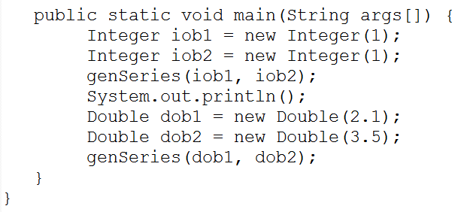
Bounded Type Example – 2

Slide 36
Using Wildcard Arguments
Instead of the typed parameter in generics (T) one can use “?” to represent an unknown type.
The “?” is act as placeholder for real arguments to be passed while calling method.
In a Stats class, assume that we want to add a method called sameAvg() that determines if two Stats objects contain arrays that yield the same average, no matter what type of numeric data each object holds.

Slide 37
Using Wildcard Arguments
For example, if one object contains the double values 1.0, 2.0, and 3.0, and the other object contains the integer values 2, 1, and 3, then the averages will be the same.
One way to implement sameAvg() is to pass it a Stats argument, and then compare the average of that argument against the invoking object, returning true only if the averages are the same.

Slide 38
Using Wildcard Arguments
Code for above scenario is something like this –

Slide 39
Using Wildcard Arguments
And the sameAvg() would be like this –

Slide 40
Using Wildcard Arguments
The trouble with this attempt is that it will work only with other Stats objects whose type is the same as the invoking object.
For example, if the invoking object is of type Stats<Integer>, then the parameter ob must also be of type Stats<Integer> not an object of type Stats<Double>.

Slide 41
Using Wildcard Arguments
To create a generic sameAvg( ) method, you must use another feature of Java generics: the wildcard argument.
Thus sameAvg() become –

Slide 42
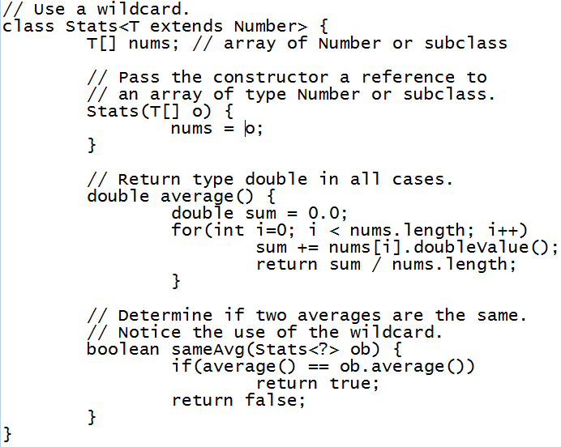
Wildcard Example

Slide 43
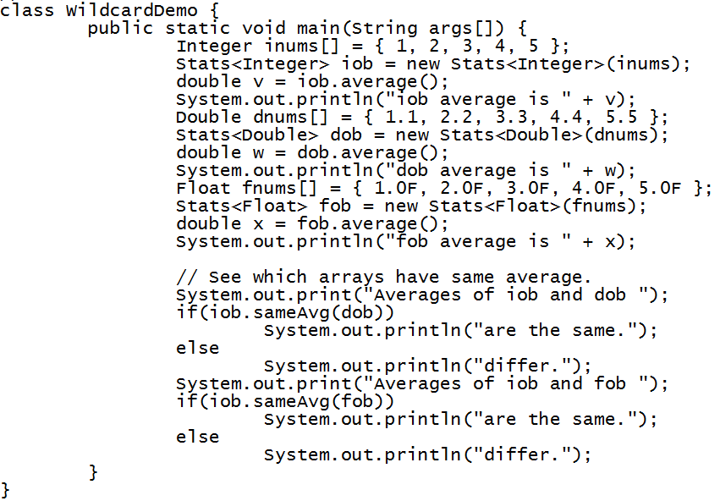
Wildcard Example

Slide 44
Using Wildcard Arguments
The wildcard does not affect what type of Stats objects can be created.
This is governed by the extends clause in the Stats declaration.
The wildcard simply matches any valid Stats object.

Slide 45
Bounded Wildcards
Wildcard arguments can be bounded in much the same way that a type parameter can be bounded.
A bounded wildcard is especially important when you are creating a generic type that will operate on a class hierarchy.
Wildcard arguments are declared in three ways.
Wildcard Arguments With An Unknown Type
Wildcard Arguments with An Upper Bound
Wildcard Arguments with Lower Bound

Slide 46
Wildcard Arguments With Upper Bound
Consider a scenario – At the top of the hierarchy is TwoD, which encapsulates a two-dimensional, XY coordinate.
TwoD is inherited by ThreeD, which adds a third dimension, creating an XYZ coordinate.
ThreeD is inherited by FourD, which adds a fourth dimension (time), yielding a four-dimensional coordinate.

Slide 47
Wildcard Arguments With Upper Bound
Shown next is a generic class called Coords, which stores an array of coordinates:

Slide 48
Wildcard Arguments With Upper Bound
Coords specifies a type parameter bounded by TwoD.
This means that any array stored in a Coords object will contain objects of type TwoD or one of its subclasses.
Now, assume that you want to write a method that displays the X and Y coordinates for each element in the coords array of a Coords object.

Slide 49
Wildcard Arguments With Upper Bound
Because all types of Coords objects have at least two coordinates (X and Y), this is easy to do using a wildcard, as shown here:

Slide 50
Wildcard Arguments With Upper Bound
However, what if you want to create a method that displays the X, Y, and Z coordinates of a ThreeD or FourD object?
The trouble is that not all Coords objects will have three coordinates, because a Coords<TwoD> object will only have X and Y.

Slide 51
Wildcard Arguments With Upper Bound
Therefore, how do you write a method that displays the X, Y, and Z coordinates for Coords<ThreeD> and Coords<FourD> objects, while preventing that method from being used with Coords<TwoD> objects?
The answer is the bounded wildcard argument.
A bounded wildcard specifies either an upper bound or a lower bound for the type argument.

Slide 52
Wildcard Arguments With Upper Bound
The bounded wildcards enables you to restrict the types of objects upon which a method will operate.
The most common bounded wildcard is the upper bound, which is created using an extends clause in much the same way it is used to create a bounded type.
Using a bounded wildcard, it is easy to create a method that displays the X, Y, and Z coordinates of a Coords object, if that object actually has those three coordinates.

Slide 53
Wildcard Arguments With Upper Bound
For example, the following showXYZ( ) method shows the X, Y, and Z coordinates of the elements stored in a Coords object, if it has.
To achieve this an extends clause has been added to the wildcard in the declaration of parameter c (generic parameter).
It states that the ? can match any type as long as it is ThreeD, or a class derived from ThreeD.

Slide 54
Wildcard Arguments With Upper Bound
Thus, the extends clause establishes an upper bound that the ? can match.
Because of this bound, showXYZ() can be called with references to objects of type Coords<ThreeD> or Coords<FourD>, but not with a reference of type Coords<TwoD>.

Slide 55
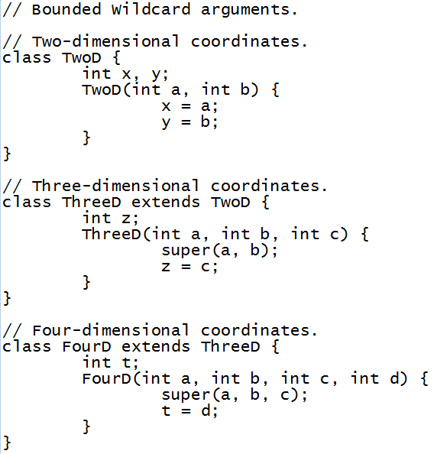
Wildcard Arguments With Upper Bound Example

Slide 56
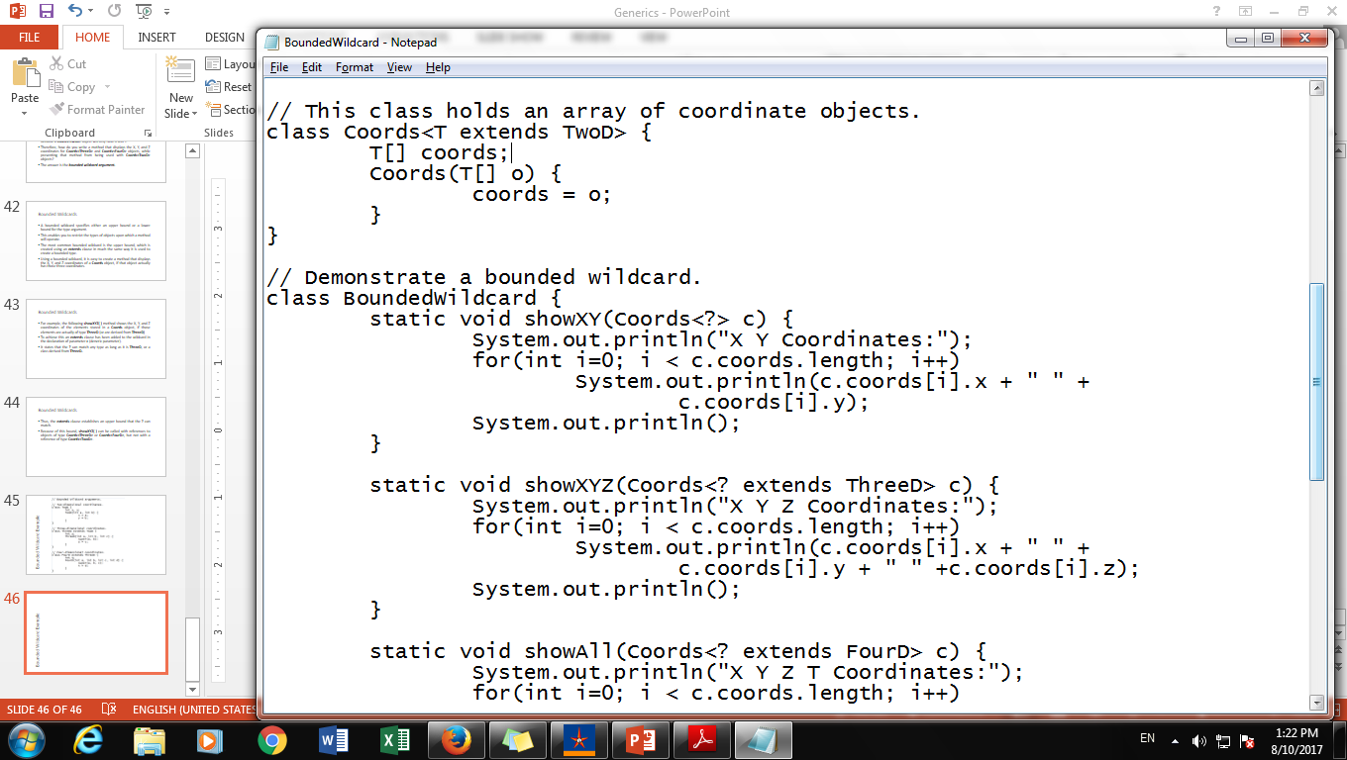
Wildcard Arguments With Upper Bound Example

Slide 57
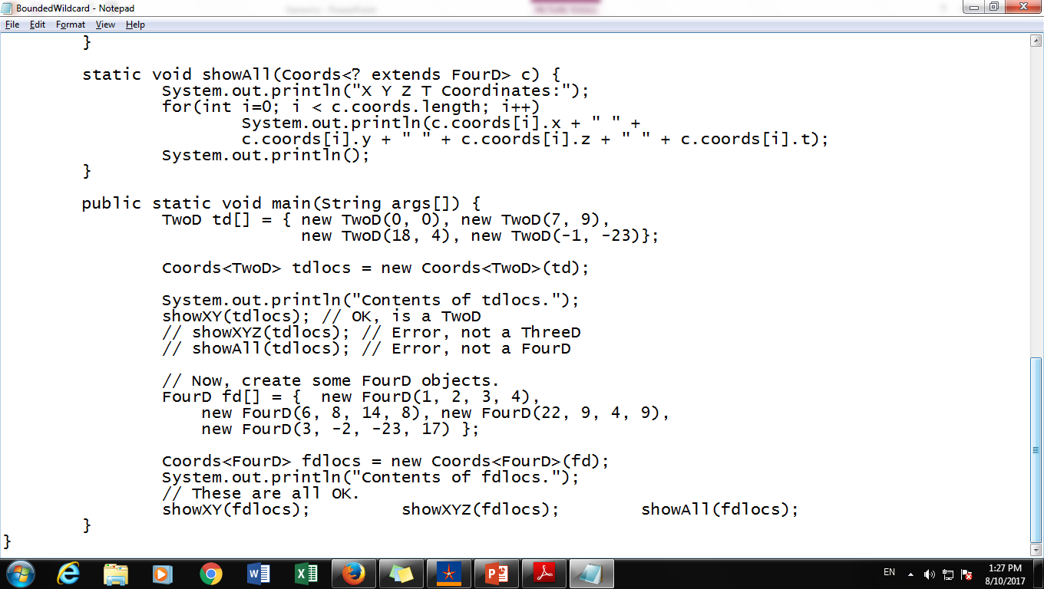
Wildcard Arguments With Upper Bound Example

Slide 58
Wildcard Arguments With Lower Bound
One can also specify a lower bound for wildcard argument using super clause.
The syntax for this is
GenericType<? super SubClass>
This means that a wildcard argument can contain ‘SubClass’ type or it’s super classes.
E.g. for Integer super class is Number and thus one can use Float with it.

Slide 59
Wildcard Arguments With Unbound
Bounded and unbounded wildcards in generics are used to bound any Type.
Single <?> is called an unbounded wildcard in generic and it can represent any type, similar to Object in Java.
For example List<?> can represent any List e.g. List<String> or List<Integer> its provides highest level of flexibility on passing method argument.

Slide 60
Execise for Generic Class
Write a generic method to exchange the positions of two different elements in an array.

Slide 61
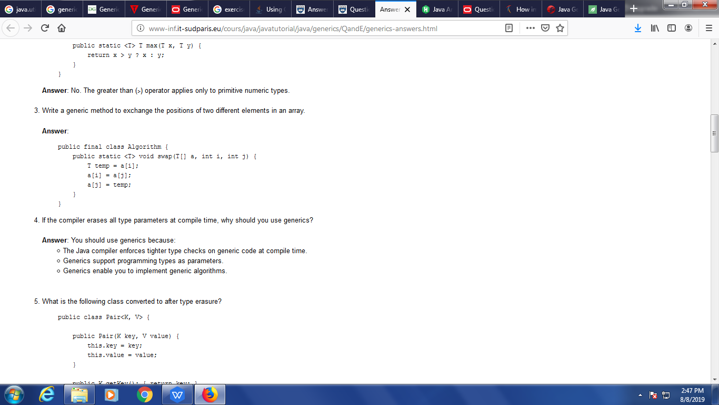
Execise for Generic Class
Write a generic method to exchange the positions of two different elements in an array.

Slide 62
Execise for Generic Class
Write a generic method to find the maximal element in the range [begin, end) of a list.

Slide 63
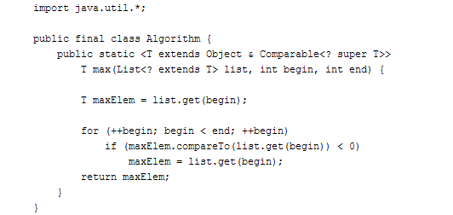
Execise for Generic Class
Write a generic method to find the maximal element in the range [begin, end) of a list.

Slide 64
Reference
Java The Complete Reference by HERBERT SCHILDT.

